Slide 1
Invention & Early Years
Film 2700- A History of Motion Pictures

Slide 2
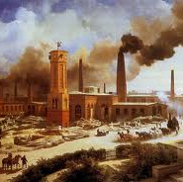
The Industrial Revolution
Spans the 18th and 19th centuries
Agrarian rural societies become industrial and urban
Shift toward powered, special purpose machinery, factories, and mass production
Advancements in transportation, communication and banking

Slide 3
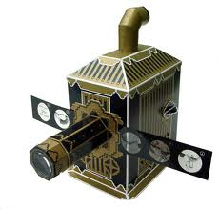
Early Visual Entertainment
  The 19th century (1800s) saw a “vast proliferation of visual forms of pop culture”
  Lantern slides
  Books of photographs
  Illustrated fiction

Slide 4
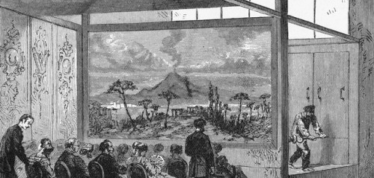
Dioramas

Slide 5
Other forms of visual entertainment
Circuses
Amusement Parks
Music Halls
Freak Shows
Theatrical Productions

Slide 6
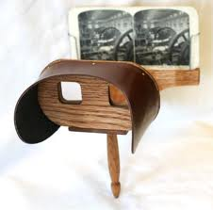
Stereoscope
Usually handheld
Created a 3D effect by juxtaposing two images
Allowed users to view exotic locales, historical events, and literary scenes and characters

Slide 7
Perceived Motion
“First, scientists had to realize that the human eye will perceive motion if a series of slightly different images his place before it in rapid succession – minimally, around 16 per second.”
Flipbook:
http://www.youtube.com/watch?v=FH97UerMW6I
Zoetrope:
http://www.youtube.com/watch?v=-3yarT_h2ws

Slide 8
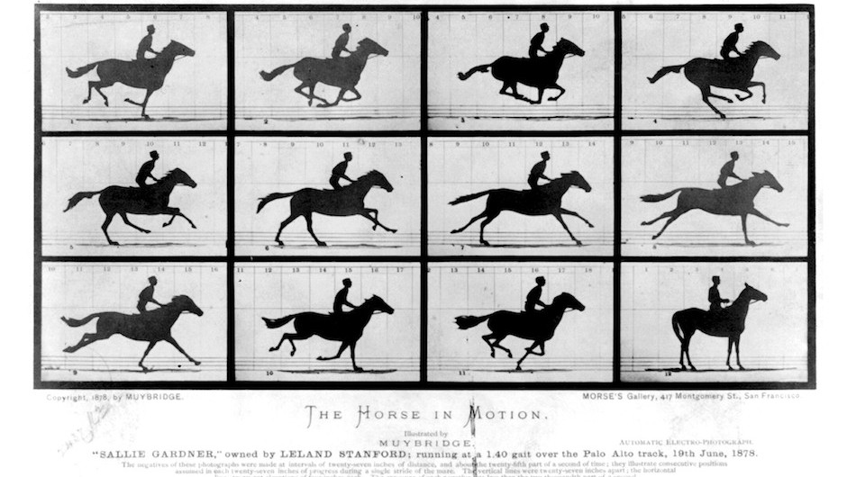
Eadweard Muybridge

Slide 9
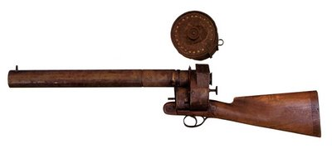
Étienne Jules Marey

Slide 10
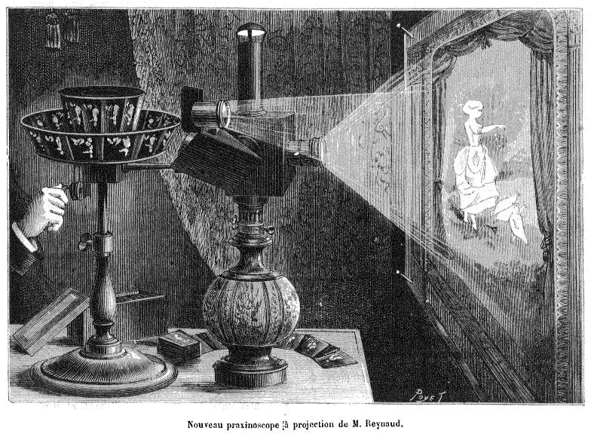
Reynaud’s Praxinoscope

Slide 11
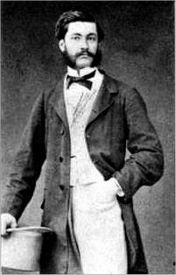
Augustin Le Prince
In 1888, Le Prince makes a series of short films using Kodak’s paper roll film
However, in order to be projected, they needed to be printed on a transparent strip
In 1890, Prince mysteriously vanishes
http://www.youtube.com/watch?v=0tDLO7VByUc

Slide 12
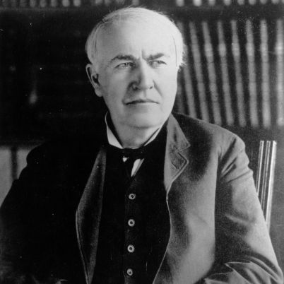
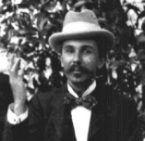
Edison & Dickson

Slide 13
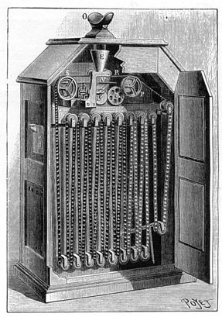
The Kinetoscope
Dickson sliced film stock into 1” strips, spliced them end to end, and punched four holes on either side of each frame
Film was exposed at 46 frames per second
Kinetoscope films can be shown in modern projectors

Slide 14
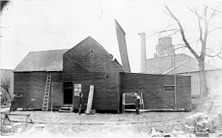
The Black Maria
In 1893, Edison and Dickson construct the Black Maria on the grounds of Edison’s New Jersey lab
The roof opens to admit sunlight
Named after police paddy wagons
http://www.youtube.com/watch?v=CjSNrfpPFCg

Slide 15
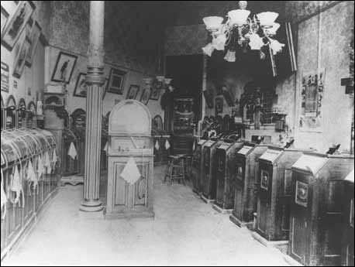
Kinetoscope Parlors
The first Kinetoscope parlor opened in NYC in 1894
Similar to phonograph parlors
More on the workings of the Kinetoscope: http://www.youtube.com/watch?v=SRIjUYh3MEs

Slide 16
The Lumière Brothers
Invent the Cinématographe around 1894
Based on the design of a sewing machine, it uses 35mm film
Workers Leaving the Factory (1895) is the first film made with the Cinématographe: http://www.youtube.com/watch?v=DEQeIRLxaM4
Records and projects (when used with a magic lantern)

Slide 17
More Lumière Brothers
December 28, 1895, at the Grand Café in Paris, the Lumière brothers gave the first publicly accessible projected screening
25 minute program of 10 films including The Waterer Watered (1895): http://www.youtube.com/watch?v=Frl0K09o-KA
            The films made by the Lumière’s differed from the ones made by Edison and Dickson- They were known as “actualities” and were short documentary style films

Slide 18
Conclusion
        By 1897, the invention of the cinema was essentially completed
          There were two primary means of exhibition -- peepshow devices and projection systems
          Likewise, there were two primary types of films being made – actualities (like those made by the Lumière brothers), and short, staged, theatrical works (like those made by Edison and Dickson)

